Slide 1
DBMS
Lecture # 13-14

Slide 2
Relational Algebra
The relational algebra is a procedural query language
It is a language in which we can ask questions (query) to a database.
It consists of a set of operations that take one or two relations as input and produce a new relation as their result
There are some basic operations of relational algebra.
These operations enable a user to specify basic retrieval requests (or queries)

Slide 3
Relational Algebra
The relational algebra is a theoretical language with operations that work on one or more relations to deﬁne another relation without changing the original relation(s).
There are many variations of the operations that are included in relational algebra. Codd (1972) originally proposed major operations, but several others have been developed.

Slide 4
Relational Algebra
The fundamental operations in the relational algebra are select, project, union, set difference, Cartesian product, and rename
The select, project, and rename operations are called unary operations, because they operate on one relation
The other three operations operate on pairs of relations and are, therefore, called binary operations

Slide 5
Unary Operations
These are those operations, which involve only one relation or table
These are:
Select
Project
Rename

Slide 6
Binary Operations
These are those operations, which involve pairs of relations and are, therefore called binary operations
The input for these operations is two relations and they produce a new relation without changing the original relations
These operations are:
Union
Intersection
Set difference
Cartesian product

Slide 7
Select Operation
The select operation is performed to select certain rows or tuples of a table, so it performs its action on the table horizontally
The tuples are selected through this operation using a predicate or condition
This command works on a single table and takes rows that meet a specified condition, copying them into a new table
Denoted by lower Greek letter sigma (σ)
σ<selection condition>(R)
Ex:- find all employees born after 1st Jan 1950:
^{σ} '01/JAN/1950'^{(employee)}

Slide 8
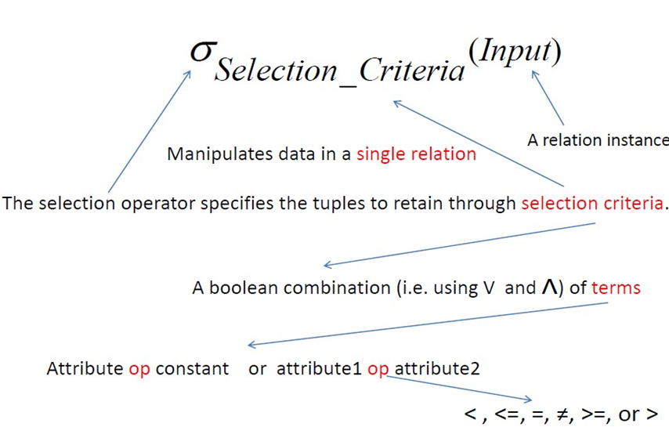
Selection Detailed Syntax

Slide 9
Example
Person
Name Address Hobby
Id
1123
1123
5556
9876
John
John Mary Bart
123 Main
123 Main
7 Lake Dr
5 Pine St
stamps
coins hiking stamps
σ Hobby=‘stamps’(Person)
Name Address
John 123 Main
Id
Hobby
1123
stamps
9876
Bart
5 Pine St
stamps

Slide 10
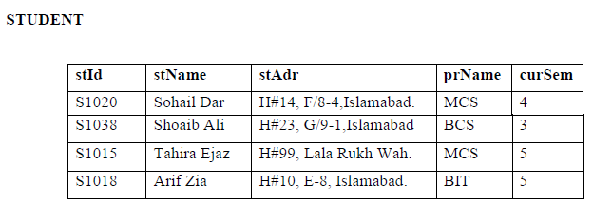

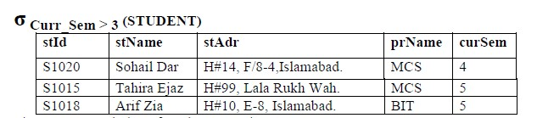
Another Example

Slide 11
Another Example
Select the EMPLOYEE tuples whose department number is 4:
σ _{DNO = 4} (EMPLOYEE)
Select the employee tuples whose salary is greater than
$30,000:
σ
SALARY > 30,000 ^{(EMPLOYEE)}
Select the instructors in Physics with a salary greater than $90,000, (and (𝖠), or (∨), and not (￢))
σ dept name =“Physics” 𝖠 salary>90000 (instructor )

Slide 12
Other operators
In selection operation the comparison operators like <, >, =, <=, >=, <> can be used in the predicate
A predicate is an expression of one or more variables defined on some specific domain.
Similarly, we can also combine several simple predicates into a larger predicate using the connectives and (^ ) and or (˅).

Slide 13
More Detail about Selection
Set of tuples of r that satisfy p
Notation: σ _{p}(r)
p is called the selection predicate
Defined as:
σ_{p}(r) = {t | t ∈ r and p(t)}
Where p is a formula in propositional calculus consisting of
predicates
connectives : ∧ (and), ∨ (or), ¬ (not) A predicate is one of:
<attribute>
<attribute>
op <attribute> or
op <constant>
where op is one of: =, ≠, >, ≥, <, ≤.

Slide 14
Selection Another Example (Operator)
A | B | C | D
Relation r
α | α | 1 | 7
α | β | 5 | 7
β | β | 12 | 3
β | β | 23 | 10
A | B | C | D
^{σ}A=B ^ D > 5 ^{(r)}
α | α | 1 | 7
β | β | 23 | 10

Slide 15
Selection Another view
cust
cid | cname | rating | salary
21 | Y. Yuppy | 5 | 95
50 | B. Rusty | 10 | 65
55 | S. Sneezy | 8 | 70
^{σ}rating >7^{(cust)}
𝑎𝑛𝑠 𝐼, 𝐶, 𝑅, 𝑆
← 𝑐𝑢𝑠𝑡 𝐼, 𝐶, 𝑅, 𝑆 , 𝑅 > 7.
cid | cname | rating | salary
50 | R. Rusty | 10 | 65
55 | S. Sneezy | 8 | 70

Slide 16
Project Operation
The Select operation works horizontally on the table on the other hand the Project operator operates on a single table vertically
It produces a vertical subset of the table, extracting the values of specified columns, eliminating duplicates, and placing the values in a new table

Slide 17
Project Operation
It is unary operation that returns its argument relation, with certain attributes left out
Since relation is a set any duplicate rows are eliminated
Projection is denoted by a Greek letter (Π )/(symbol: π (pi))
While using this operator all the rows of selected attributes of a relation are part of new relation
∏ <attribute list>(relation)

Slide 18
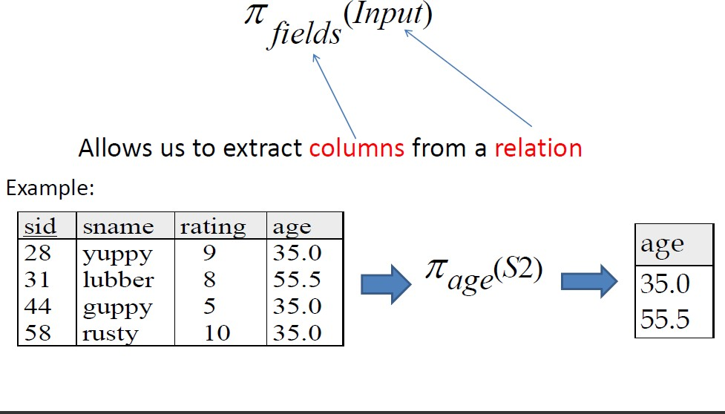
Projection Syntax

Slide 19
Simple Example
Example: To list each employee’s first and last name and salary, the following is used:
^{π}LNAME, FNAME,SALARY^{(EMPLOYEE)}

Slide 20
Example
Person
Name Address Hobby
Id
∏Name,Hobby(Person)
Name Hobby
1123
1123
5556
9876
John
John Mary Bart
123 Main
123 Main
7 Lake Dr
5 Pine St
stamps
coins hiking stamps
John
John Mary Bart
stamps
coins Hiking stamps
Id
Hoby

Slide 21
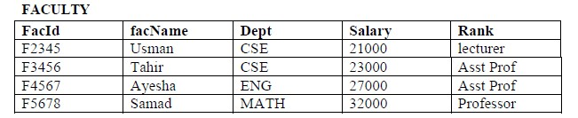
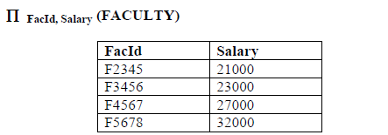
Project Operation

Slide 22
Composition of relational operators
The relational operators like select and project can also be used in nested forms iteratively
As the result of an operation is a relation so this result can be used as an input for other operation
Order is very important

Slide 23
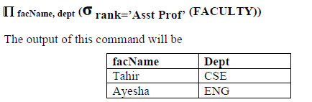
Example

Slide 24
Rename
RENAME (symbol: ρ (rho))
The general RENAME operation ρ can be expressed by any of the following forms:
ρ_{S}(R) changes:
the relation name only to S
ρ_{(B1, B2, …, Bn )}(R) changes:
the column (attribute) names only to B1, B1,…..Bn
ρ_{S (B1, B2, …, Bn )}(R) changes both:
the relation name to S, and
the column (attribute) names to B1, B1, …..Bn

Slide 25
Binary Operations
These are those operations, which involve pairs of relations and are, therefore called binary operations
The input for these operations is two relations and they produce a new relation without changing the original relations
These operations are:
Union
Intersection
Set difference
Cartesian product

Slide 26
Union Operations
The first requirement for union operator is that both the relations should be union compatible
It means that relations must meet the following two conditions:
Both the relations should be of same degree, which means that the number of attributes in both relations should be exactly same
The domains of corresponding attributes in both the relations should be same.

Slide 27
Union Operation
It is denoted by U
If R and S are two relations, which are union compatible, if we take union of these two relations then the resulting relation would be the set of tuples either in R or S or both
Since it is set so there are no duplicate tuples
The union operator is commutative which means:
R U S = S U R
RESULT ← R ∪ S

Slide 28
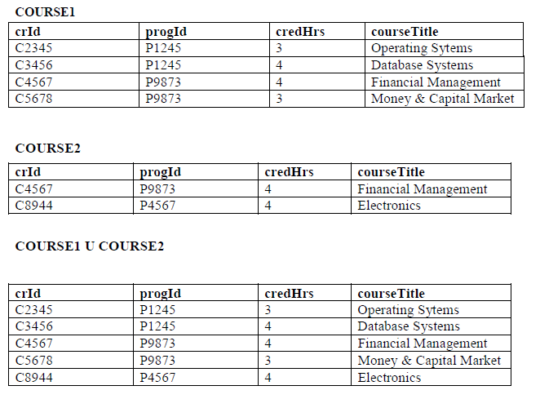
Example

Slide 29
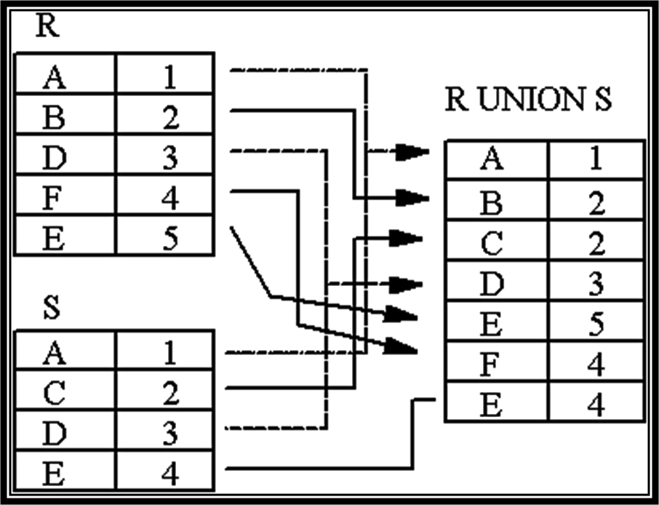
Another Example

Slide 30
Note:
Tables:
Person (SSN, Name, Address, Hobby) Professor (Id, Name, Office, Phone)
are not union compatible. However
Π _{Name} (Person) and Π _{Name} (Professor) are union compatible and
15

Slide 31
Intersection Operation
The intersection operation also has the requirement that both the relations should be intersection compatible i.e they are of same degree and same domains. It is represented by
If R and S are two relations and we take intersection of these two relations then the resulting relation would be the set of tuples, which are in both R and S
Just like union intersection is also commutative.
R S = S R

Slide 32
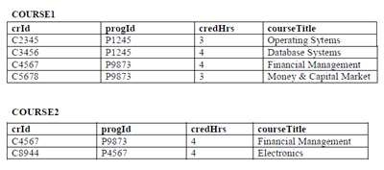
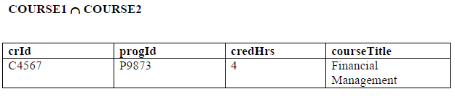
Example

Slide 33
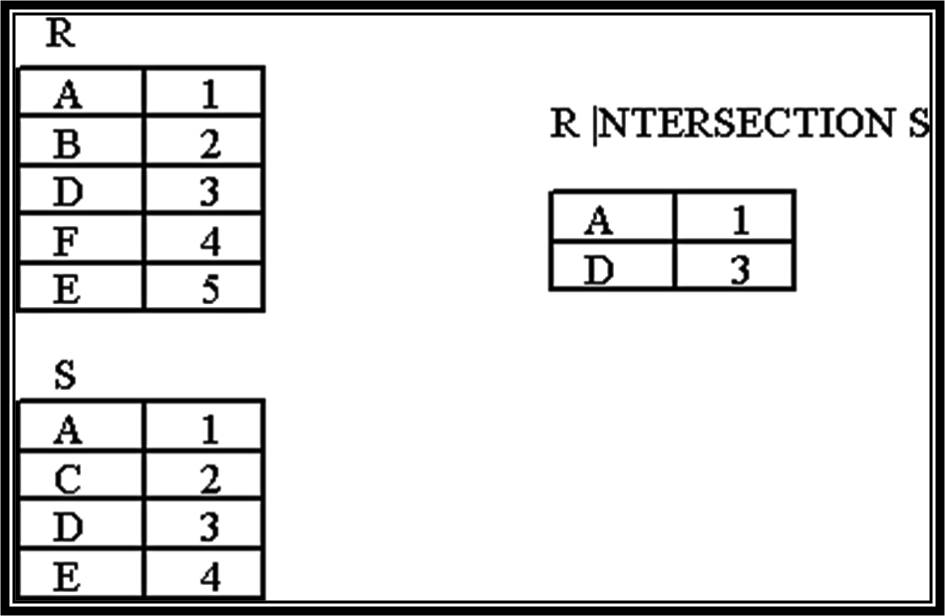
Another Example

Slide 34
Set Difference Operation
If R and S are two relations which are union compatible then difference of these two relations will be set of tuples that appear in R but do not appear in S. It is denoted by (-)

Slide 35
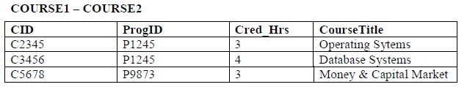
Example

Slide 36
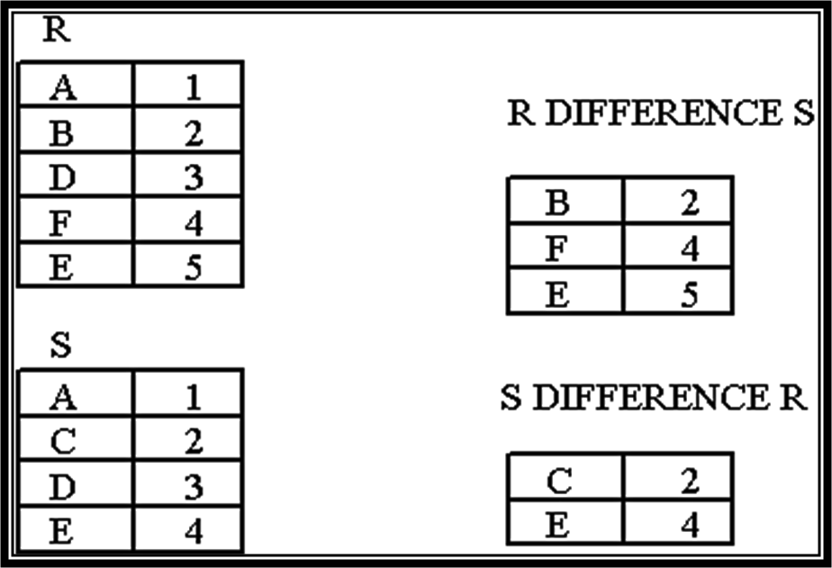
Another Example

Slide 37
Set Difference Operation
If R and S are two relations which are union compatible then difference of these two relations will be set of tuples that appear in R but do not appear in S. It is denoted by (-)

Slide 38
Union, Intersection, Set- Difference Notations
Notation: r ∪ s r ∩ s r – s
Defined as:
r ∪ s = {t | t ∈ r or t ∈ s} r ∩ s ={ t | t ∈ r and t ∈ s } r – s = {t | t ∈ r and t ∉ s}
For these operations to be well-defined:
r, s must have the same arity (same number of attributes)
The attribute domains must be compatible
(e.g., 2nd column of r has same domain of values as the 2nd column of s)

Slide 39
Thanks

